Slide 1
CubeSat
Critical Design Review

Slide 2
Agenda
Charlie
Introduction
Motivation
Approach
Budget
Design
Standards
FMEA
Conclusion

Slide 3
Introduction
Charlie
Communications
Ben Setterholm
Tim Kukowski
Team Lead/Structure
Charles Denis
ADNCS
Jacob Gustafson
Brian Hanson
Nicholas Sloan
Power Management
Ethan Arendt
Justin Seifert
Nicholas Janak

Slide 4
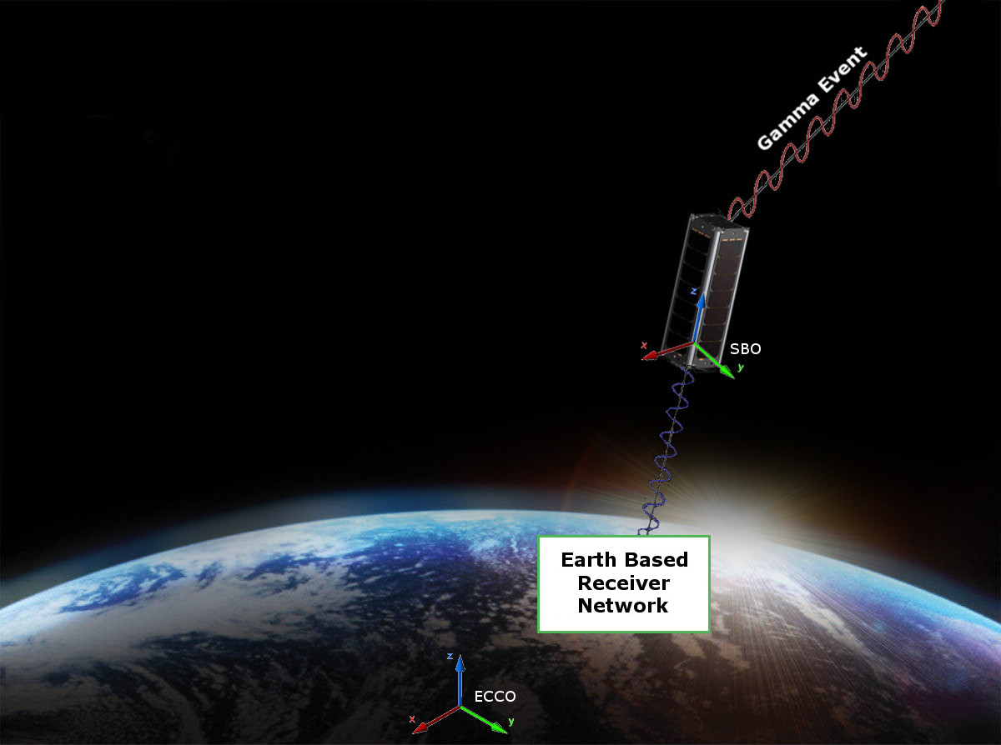
Motivation
Charlie

Slide 5
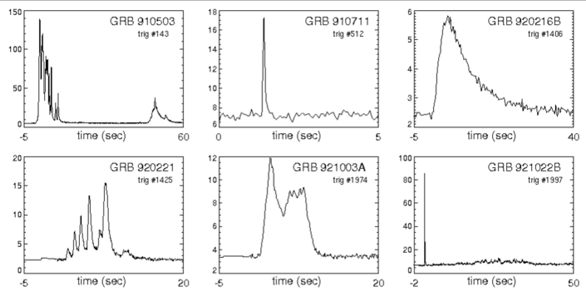
Motivation
Charlie
Payload
Gamma Ray Intensity Detector (GRID)
What GRID does?
Detect Gamma Ray Events to conceptually prove deep space navigation concepts
Figure 1. This figures shows six examples of known Gamma Ray bursts from our universe. The data in the plots represents the relation between Kilo-Electron Volts and Seconds in time.

Slide 6
Motivation
Tim K
Requirements
The CubeSat shall determine and relay a relative position solution (i.e., relative to the formation) with an accuracy of 10 meters (1 standard deviation)
The CubeSat shall determine and relay a relative attitude solution with an accuracy of 10 mRad.
The CubeSat shall maintain a clock offset or timing accuracy (relative to the formation) better than 10 µs.

Slide 7
Motivation
Tim K
Derived Requirements
Shall accept “GRID” as a payload
Supplies payload with power (3~5W/hr) and communication requirements
Provides environmental data (time, attitude, position) to payload with priority
Receives data from payload to transmit to ground network
Shall meet NASA CubeSat Launch Initiative requirements
Structural, electrical, and other requirements are listed at
http://www.nasa.gov/pdf/627972main_LSP-REQ-317_01A.pdf

Slide 8
Design Approach
Tim K
Goals
Off the Shelf components
Why?
Focus on design, not technology
Support for components
Subteams
Divide and conquer
One to three slides

Slide 9
Purchases
Jake G.
Flight Computer
GPS Antenna
GPS receiver
Batteries
Power Management Board
Radio
Antenna (WHIP)
Deployable Solar Panels
Gyroscopes

Slide 10
Budget
Jake G.
Initial Budget
Lower
$50,000
Middle
$75,000
Upper
$100,000
NASA Proposal

Slide 11
Final Budget
Final Cost: $80,725
Jake G.
Item | Model | Source | Cost
Flight Computer | A712D | GOMSpace | $10,800*
GPS receiver | OEM615 | Novatel | $6,000
GPS Antenna | Single Frequency MircoStrip | Antdevco | $5,000
Batteries | NanoPower BPX | GOMSpace | $6,200
Power Management Board | P31us | GOMSpace | $6,200
Radio | MM2-TTL | Freewave | $1,500
Antenna (WHIP) | CS-CPUT-STX-02 | ClydeSpace | $4,725?
Deployable Solar Panels | SP-L-DD1S3U-0039 | ClydeSpace | $40,300*
Gyroscopes | ? | ? | ?
* Denotes the cost of 2

Slide 12
Design - Model
Charlie D
Solidworks Model HERE

Slide 13
Design - Structure
Charlie
Century College to Manufacture to Specifications
Sub Contracted by UMN

Slide 14
Design - Structure
Charlie
Thermal environment ( heat shielding )

Slide 15
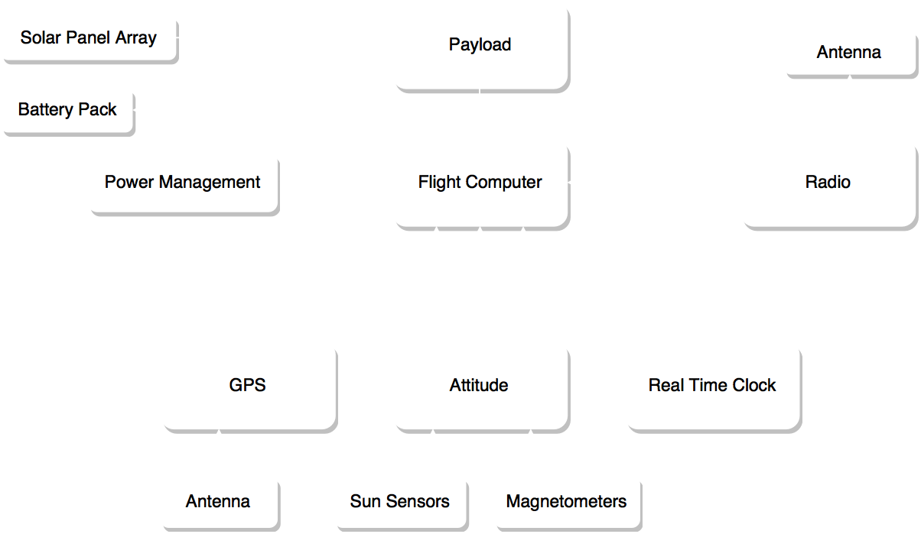
Design

Slide 16
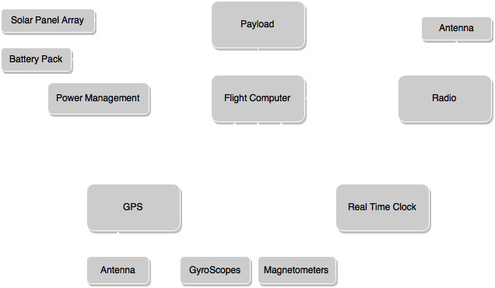
Wiring
Jake G
Voltage
CAN
I2C
Serial
Serial
Onboard
I2C
Onboard

Slide 17
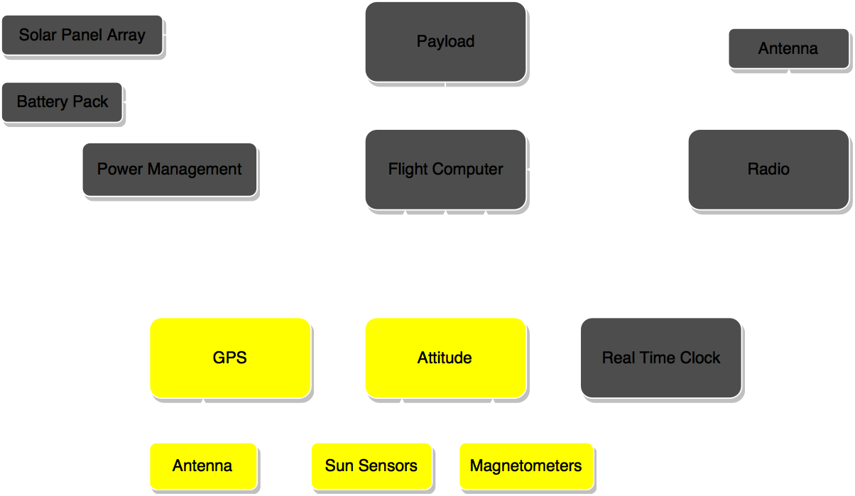
Design - ADNCS

Slide 18
DESIGN - ADNCS Overview
Nick S
Attitude Determination
Gyroscopes
Magnetometers
Passive Magnetic Attitude Control
Pointing Accuracy <5º
GPS

Slide 19
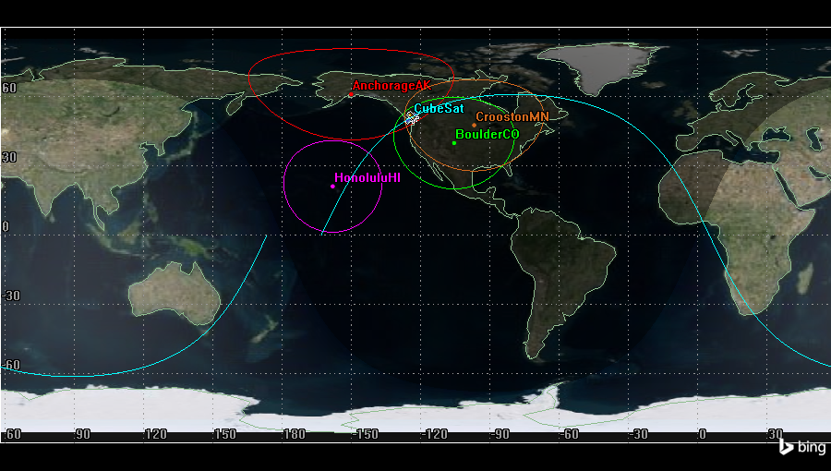
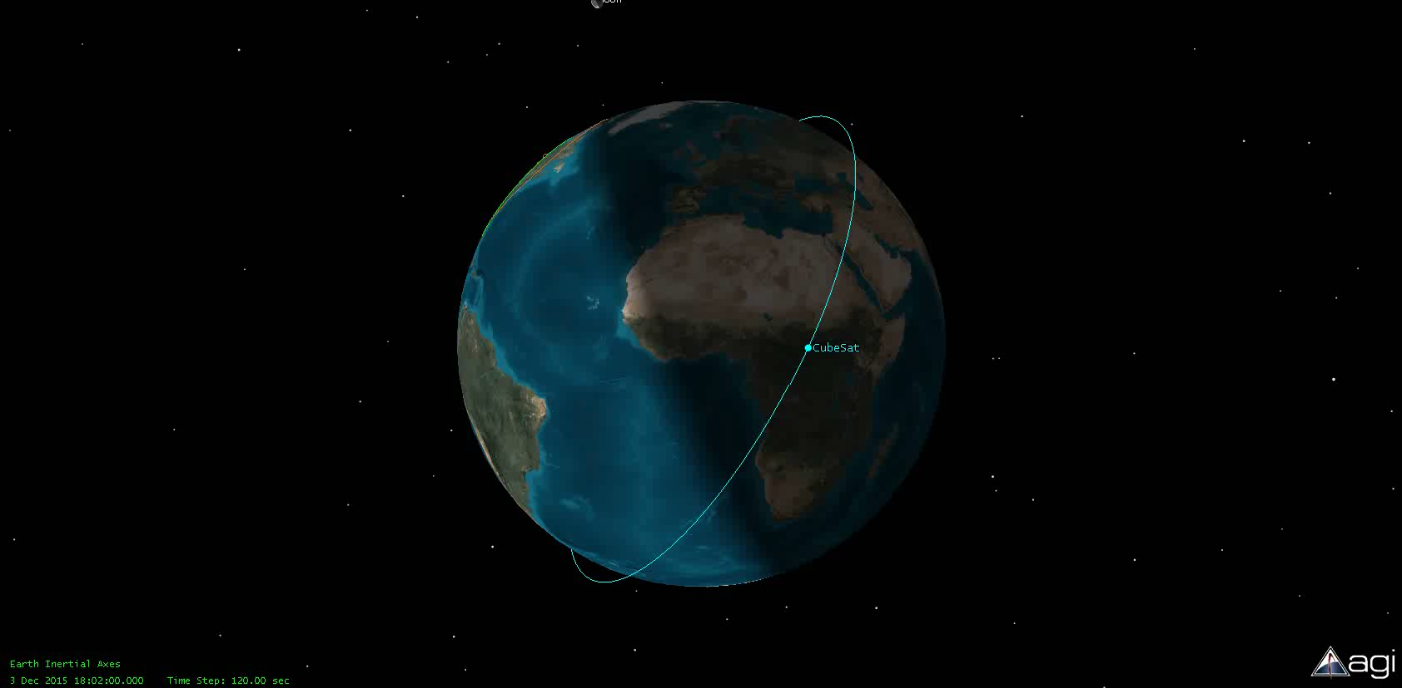
Design - ADNCS
Orbit
Altitude: 410 Km
Inclination: 60 Degrees
Jake G
Notes:
Moved this slide due referencing STK and orbits before GPS

Slide 20
DESIGN ADNCS
Nick S
Passive control mathematatatatatics
why passive?
power savings, etc
FMEA analytics

Slide 21
DESIGN ADNCS
Jake G
GPS (Novatel 615 with Single Frequency MircoStrip)
Output (50 Hz)
GPS Time
GPS Position and Standard deviation
GPS velocity and Standard deviation
Number of Satellites

Slide 22
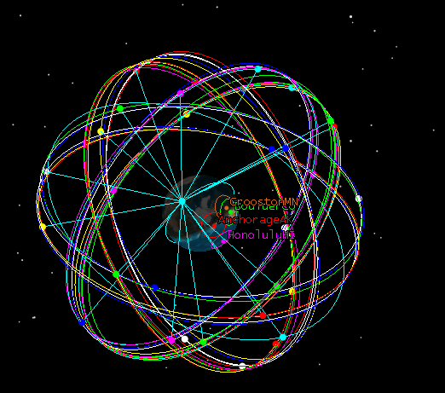
Verification of Satellites
Jake G
Need 4 satellites
Verification done with STK

Slide 23
DESIGN ADNCS
Brian H
Attitude determination
High level description, inputs, etc.

Slide 24
Design – Requirements for GRID/GPS

Slide 25
Design – Requirements for GRID/GPS
NAME
GRID/GPS may generate up to 20 MB per GRB event
GRID/GPS must save data files in 128 KB packets (maximum).
Must use logical data naming structure
Flight computer must generate and save a checksum for each packet file individually

Slide 26
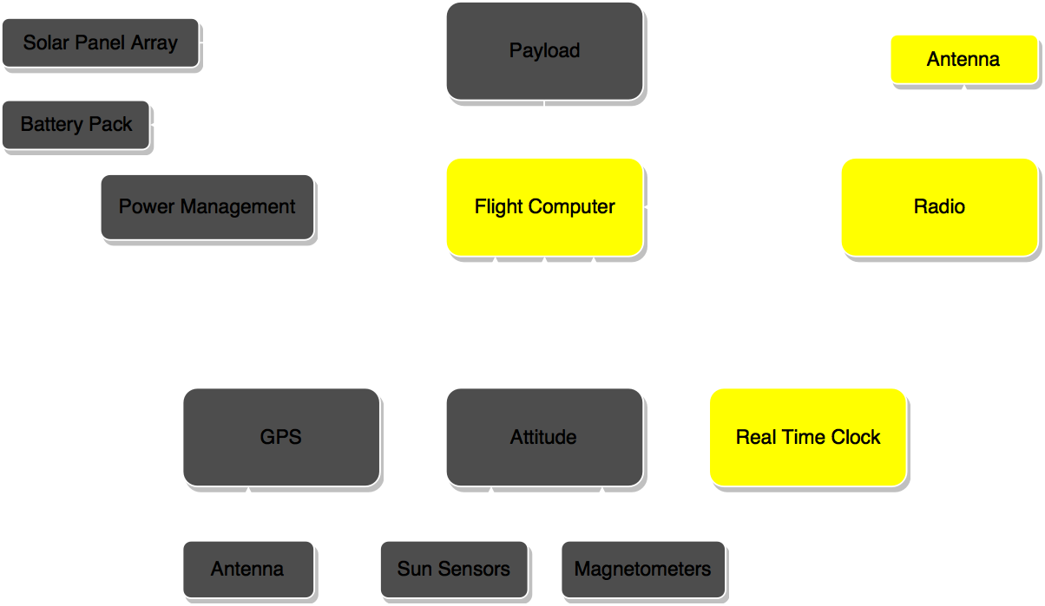
Design - Communications

Slide 27
Design - Communications Overview
NAME
Maximum total theoretical data that can be transferred per day: 50 MB
Expected effects reducing this value
Weather
Communications Algorithm
Random Data Errors
Expected science data transfer per day: 15 MB
Guaranteed total data transfer per day: 10 MB
Notes:
Predicted assumes 40% weather throughput, maximum expected data errors, and 1 MB of other data transferred per day (handshakes, diagnostics, log files)

Slide 28
Design - Communications Hardware
Tim K
FreeWave Radio @ 915MHz
Whip Antenna
TO BE COMPLETED

Slide 29
Design – Communications Algorithm
Ben
Step 1: Active Pinging
Check if any other ground stations are currently in contact with CubeSat
If not, send hail signal once every 3 seconds

Slide 30
Design – Communications Algorithm
Ben
Step 2: Establish Connection
CubeSat replies to hail
CubeSat transmits GPS location, heading, and velocity information
CubeSat transmits number of files ready for downlink

Slide 31
Design – Communications Algorithm
Ben
Step 3: Computation
Ground station determines communication time

Slide 32





Design – Communications Algorithm
Ben
Step 3: Computation
Ground station determines communication time
2°
2000 km

Slide 33


Design – Communications Algorithm
Ben
CubeSat makes contact
Determine range
Step 3: Computation
Ground station determines communication time

Slide 34
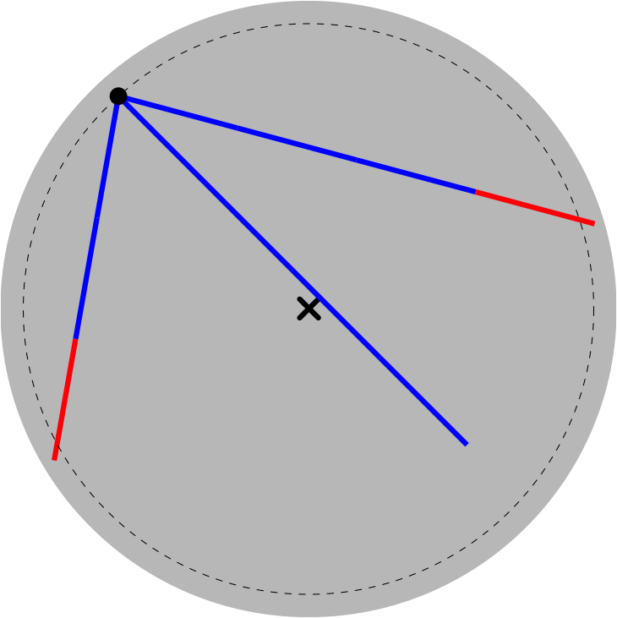
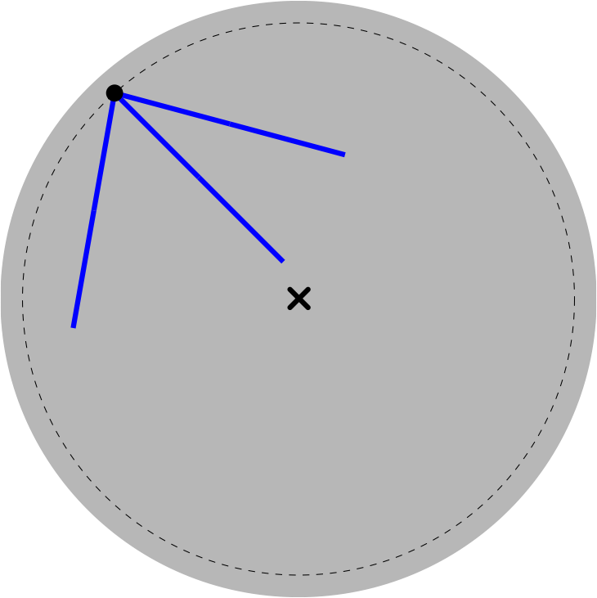
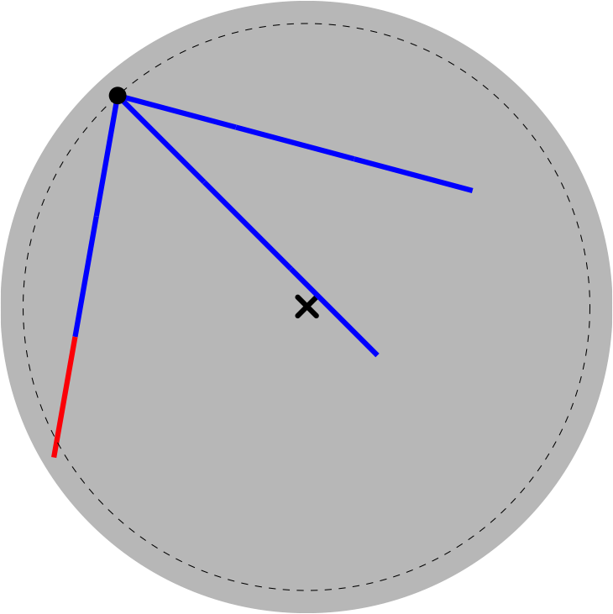
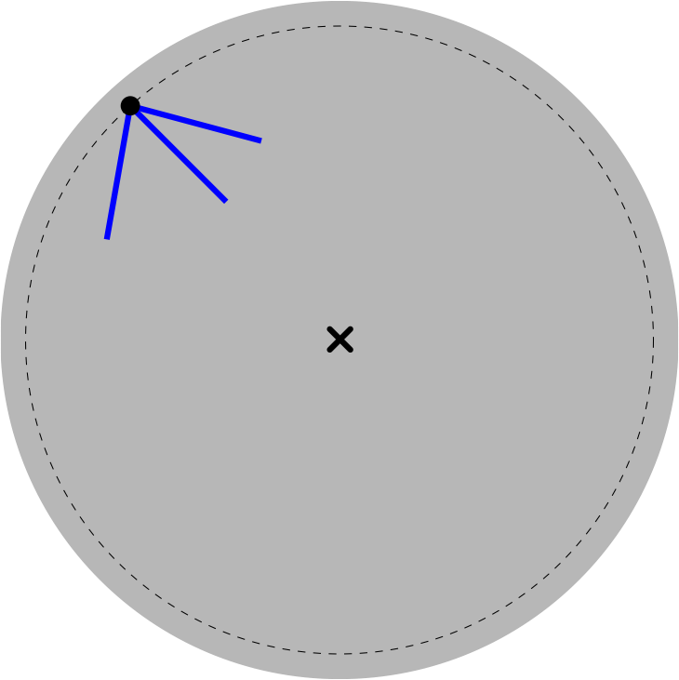
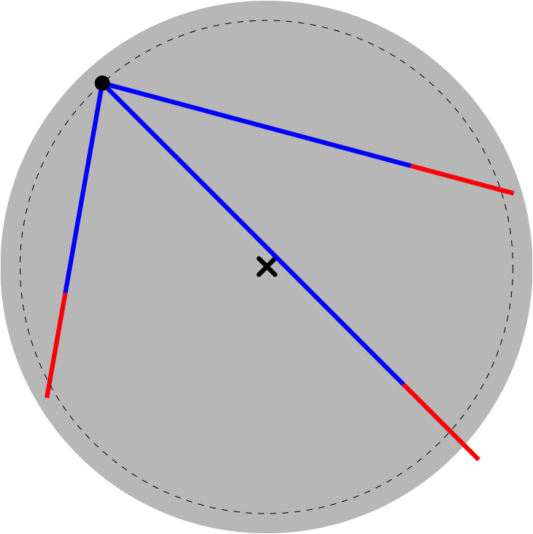
Design – Communications Algorithm
Ben
CubeSat makes contact
Determine range
Forward time step
3 second intervals
Step 3: Computation
Ground station determines communication time

Slide 35
Design – Communications Algorithm
Ben
Step 4: Command
Ground Station sends command code
transfer queued file
transfer log file
diagnostics
delete queued file
CubeSat purges marked files
delete all data files
delete log file
reboot OS
goodbye

Slide 36
Design – Communications Algorithm
Ben
Step 5: Transmit Data
CubeSat transmits one 128 kB packet
5 time steps

Slide 37
Design – Communications Algorithm
Ben
Step 6: Error Checking
Ground Station computes checksum
Ground Station transmits checksum

Slide 38
Design – Communications Algorithm
Ben
Step 7: Confirmation
CubeSat checks checksum
CubeSat relays success/failure to ground station
CubeSat appends log file
CubeSat marks file for deletion

Slide 39
Design – Communications Algorithm
Ben
Diagnostics
Onboard Time
GPS Position, Velocity, Satellite Lock
Battery Status, Panel Cell Performance
Attitude Magnetic Lock
Data Storage Check
Detector Diagnostics

Slide 40
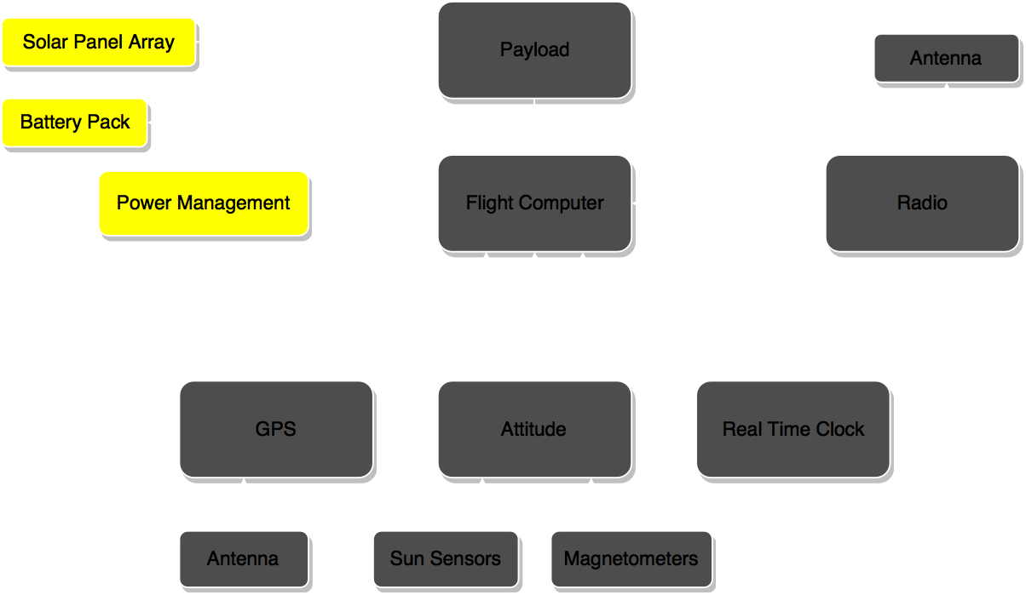
Design - Power

Slide 41
Design – Power
Justin S
Overview
Power needed
Power supplied
Initial design / needed design
deployables

Slide 42
Design - Power
Nick J
Enviromental aspects. (orbits)

Slide 43
Justin S
Power components

Slide 44
Design – Power Budget
Ethan A
charge vs discharge

Slide 45
Design - Power
Ethan A
Wiring

Slide 46
Design - Power
Nick J
Power order of operations

Slide 47
Design – Power
Nick J

Slide 48
FMEA
Ben S
TO BE COMPLETED

Slide 49
Conclusion
Nick S
Delivered:
Cubesat Hardware Design
Planned Orbit
Verfieid
TO BE COMPLETED

Slide 50
Next steps.
Brian H
Here is the next steps to be done in spring.

Slide 51
Individual Reports

Slide 52
Lessons Learned
Ben
Things take a lot longer to do than they seem they should
Lot’s of very smart people have already worked out similar problems
It’s okay to ask questions
Recycle their ideas
Open source code is readily available
Proprietary information is frustrating
STK makes life a whole lot easier
The atmosphere is a bitch
Data is always available for all frequencies except the one you are working on
Pocket calculator is sometimes more reliable than the code you wrote
Double/triple check everything

Slide 53
Individual Design Contributions
Ben
Data-Link Budget
Preliminary Power Calculations
Data Transmission Error Estimations
Verification
Orbit Determination
Altitude and inclination
Timing study
Data allowance for GRID
Crookston study
Communication Algorithm
Studies of existing algorithms
Data management requirements
Error considerations
Packet size determination
Checksum
Timing estimations
Algorithm sketch

Slide 54
Design – Data Link Budget
Ben
Driving Questions:
Can data be successfully transmitted to Earth?
How much error can be expected?
Link Budget examines power losses and gains during emission, transmission, and detection of signal
Logarithms make calculations easier

Slide 55
Design – Data Link Budget
Ben
Equivalent Isotropic Radiated Power (EIRP)
EIRP (dBW) = Antenna Power (dBW) + Antenna Gain (dB)
For CubeSat, EIRP = 1.14 dBW
Power = 1.3 W
Patch antenna is omnidirectional, so gain = 0 dB

Slide 56

Design – Data Link Budget
Ben
Free Space Losses
Dominant component of losses
Power flux density falls off as 1/r²

Slide 57
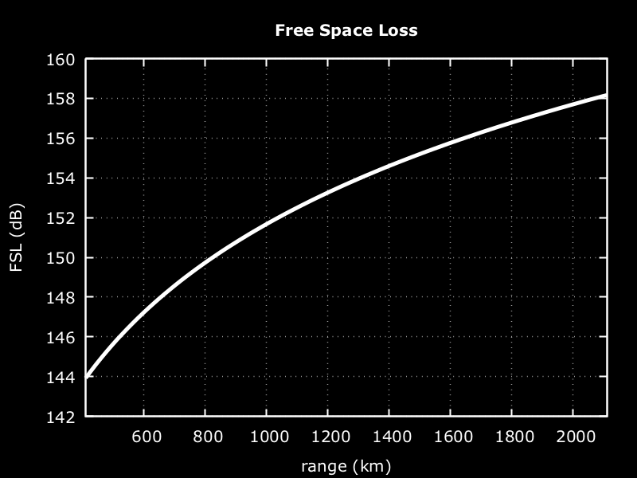
Design – Data Link Budget
Ben
FSL = 158 dB for link budget calculation

Slide 58
Design – Data Link Budget
Ben
Atmospheric Losses
Clear sky estimation
1 GHz approximation
TO BE COMPLETED. SEE PAGE 19 OF Rec. ITU-R P.676-9

Slide 59
Design – Data Link Budget
Ben
Ground Losses
TO BE COMPLETED

Slide 60
Design – Data Link Budget
Ben
Error analysis
Signal to noise
Probability of bit error
TO BE COMPLETED

Slide 61
Design – Data Link Budget
Ben
Comparison to AsterLabs info
TO BE COMPLETED

Slide 62
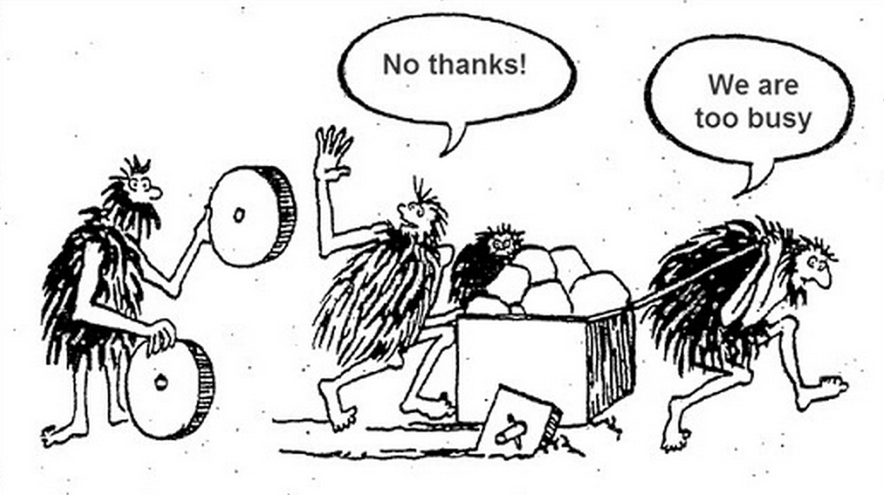
Lessons Learned
Jake G
don't reinvent the wheel
You can never know too much
Don’t be afraid to ask
(its okay to not know everything)
Double Check EVERYTHING!!!!!!!!!!!!
Remember to have fun
But only so much
https://trimaps.com/custom-map-users/interactive-map-made-easy-for-developers

Slide 63
Individual Design Contributions
Jake G
GPS
Parts Choice
Antenna Choice
Attitude determination
Initial Research on Algorithm
STK

Slide 64
STK
Jake G
Used for on CubeSat
Model
Power Budget
Link Budget
GPS Verification
Very Powerful
Not just used for Space Applications

Slide 65
Individual Design Contributions
Nick S.
Attitude determination
Initial research into hardware
Passive Magnetic Attitude Control System
Materials Sourcing
Matlab simulation and verification
Notes:
Magnets are annoying.

Slide 66
Lessons Learned
Nick S.
Importance of Consistency
Being gone for ~1 month on a 3-month projects makes things difficult
Organization makes your life easier
People want to help (so ask questions)
Space is difficult
Never stop learning
Notes:
Leaving for Australia took me out of the loop for the project and I had to spend time catching up with where things were. Keeping things together an organized makes things happen. You don’t design in a vacuum. Ask people and you can find help. One paper from our sponsor allowed me to create a matlab simulation to verify our PMACS. Putting something in space makes all of your challenges that much tougher. Orbits, reliability, power; all become really hard when you have zero-margin for failure. I also learned that in space things get hot and cold. I knew that, but never the magnitude of the variation.

